Slide 1
Camera

Slide 2
“Up”, “Forward” and “Along”
The three camera view vectors are defined as shown:

Slide 3
Proposed Camera Features
The camera class should:
Provide motion along the view vectors as well as arbitrary axes (in some cases)
Provide rotation about the view vectors as well as arbitrary axes (in some cases)
Maintain the camera’s own orientation by keeping the viewing vectors orthogonal to each other
Need to define motion for two possible types of camera:
Land camera – e.g. for road vehicles simulation
Air camera – e.g. for flight simulation

Slide 4
Camera Motion
Walking
This is motion along the Forward vector (or X-axis):

Slide 5
Camera Motion
Strafing
This is side to side motion on the Along vector (or Y-axis):

Slide 6
Camera Motion
Flying
This is vertical motion on the Up vector (or Z-axis):

Slide 7
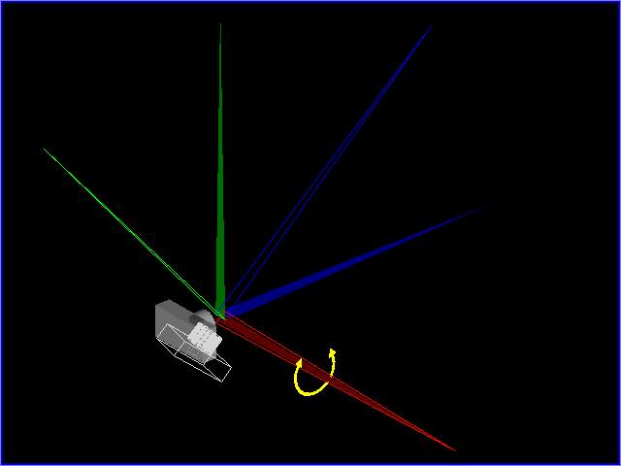
Camera Rotation
Pitching
This is rotation about the Along vector – looking up and down

Slide 8
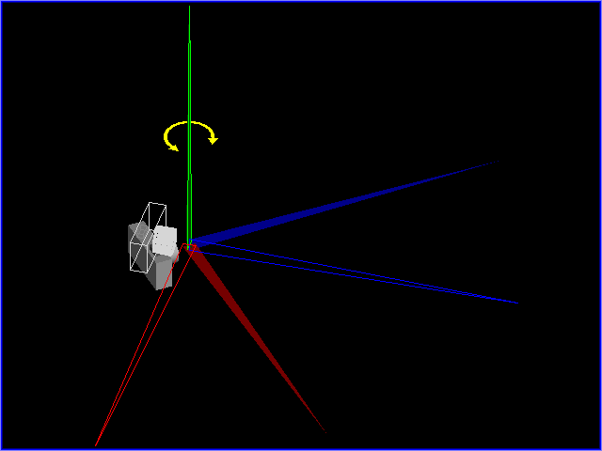
Camera Rotation
Yawing
This is rotation about the Up vector – looking left and right

Slide 9
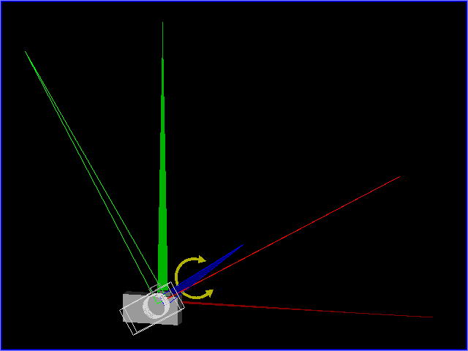
Camera Rotation
Rolling
This is rotation about the Forward vector – twisting left and right

Slide 10
See the provided camera.exe
12 movements are defines as below:
4 arrow keys, pageup, pagedown and the keys 1 to 6.
First six keys: change the position without changing the direction.
Last six keys: change the direction without changing the position.

