Slide 1
Approaches To Infinity

Slide 2
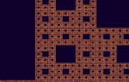
Fractals
Self Similarity
They appear the same at every scale, no matter how much enlarged.

Slide 3
Fractals
Fractal curves have infinite length within a finite region
Koch curve
Koch Snowflake
Dragon Curve
Hilbert Curve
Implemented using recursive functions
Application:
Simulating Clouds, ferns, coastlines, mountains, veins, nerves, parotid gland ducts, etc. all possess these features
fractal geometry is useful for all sorts of things from biology to physics, to cosmology, to even the stock market
fractal math is involved in JPG, MP3, MPG and other digital compression

Slide 4
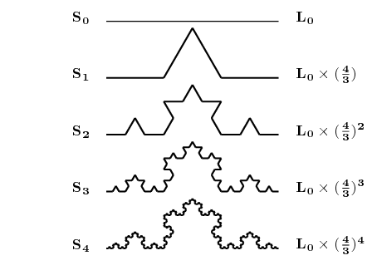
Koch curve

Slide 5
Koch Curve
Initial line: k_{o}
horizontal line having unit length
1st Generation: K₁
divide k_{o} in three equal parts
Replace the middle section with triangular bump each side having length 1/3
2nd generation: k₂
repeat the process for each of the four line segments

Slide 6
How to draw koch curve?
k_{n} generation consists of four versions of the k_{n-1} generation
To draw k2
draw a smaller version of k1
Turn left 60º, and again draw a smaller version of k1
Turn right 120º, and again draw a smaller version of k1
Turn left 60º, and again draw a smaller version of k1
Length = (4/3)
Length = (4/3)²
Recursive!

Slide 7
How to draw koch curve?
k_{n} generation consists of four versions of the k_{n-1} generation
To draw Kn:
If(n equals 0) Draw a straight line;
Else
Draw K_{n-1} ;
Turn left 60º ;
Draw K_{n-1} ;
Turn left 120º ;
Draw K_{n-1} ;
Turn left 60º ;
Draw K_{n-1} ;
Length = (4/3)
Length = (4/3)²

Slide 8
Length of Koch Curve
Length of curve for kn is (4/3)^{n}
How?
Length of K0 = 1
Length of K1 = 4 x 1/3 = 4/3
Length of K2 = 4 (4 x (1/3)/3) = 4²(1/3)²
Length of K3 = 4³(1/3)³
…
Length of Ki = 4^{i}(1/3)^{i} = (4/3)^{i};
if i tends to infinity, length tends to infinity

Slide 9
Koch Curve
A line of length L is koched
K_{o} has length L instead of unit length
Length = L
(L/3)
Length = 4(L/3)
4x(L/3)/3
(L/3)/3
Length =4x(4x(L/3)/3 ) = L (4/3)²

Slide 10
Koch Curve
A line of length L is koched
Length of K_{n} = L (4/3)^{n}

Slide 11
Koch Snowflake Curve
Starts with three koch curves joined together

Slide 12
Perimeter of Koch Snowflake Curve
Perimeter of koch snowflake curve of i^{th} generation S_{i} is three times the length of a simple koch curve
Perimeter= 3 x 1
Length = 1
Length = (4/3)
Perimeter= 3 x (4/3)
Perimeter= 3 x (4/3)²
Length = (4/3)²

Slide 13
Perimeter Koch Snowflake Curve
Perimeter of koch snowflake curve of i^{th} generation S_{i} is three times the length of a simple koch curve: perimeter of S_{i} = 3 x length of K_{i} = 3 (4/3)^{i}
As i increases, perimeter increases, boundary becomes rougher
But the area remains bounded!
perimeter of Si when i tends to infinity: lim 3 (4/3)^{i} = 8/5 S_{o}
i → ∞

Slide 14
Number of Sides of koch snow flake curve
How many sides at generation n?
N₀=3
N₁ = 12 = 4 x N₀
N₂ = 36 = 4 x N₁ = 4 x 4 x N₀ = 4² N₀
N₃ = 4³N₀
…
…
N_{n} = 4^{n} N₀ = 3 x 4^{n}
From each side, 4 new sides
From each side, 4 new sides

Slide 15
Size of the sides of Koch Snow Flake
Size of sides at iteration n?
S_{n} = 1/3^{n} (formula from koch curve) of L/3^{n}
Perimeter of Koch Snow Flake at iteration n is:
Sn x Nn = (1/3^{n} ) (3 x 4^{n})
or (L/3^{n} ) (3 x 4^{n}) =3L(4/3)^{n}
From each side, 4 new sides
From each side, 4 new sides

Slide 16
Area of Koch Snow Flake
Area of S_{o} = a_{o}
Area of S₁ = a_{o} + 3(a_{o}/9) = a_{o} + a_{o}/3 = a_{o}(1+1/3)
How do we get area of S_{n}?
S_{o}
a_{o}/9
S₁

Slide 17
Area of Koch Snow Flake
In each iteration a new bump/triangle is added at each side of previous iteration
After nth iteration,
Number of new triangles = Nn-1 = 3 x 4^{n-1}
New area included = Nn-1 x size of new bump/triangle
How do we get size of new bump/triangle at iteration n ?

Slide 18
Area of Koch Snow Flake
ao/9
Area of each small bump in S1 = ao / 9
Area of each small bump in S2 = ao / 9²
Area of each small bump in S3 = ao / 9³
… …
Area of each small bump in Sn = ao / 9^{n}
ao/9
(ao/9)/9 = ao(1/9)²

Slide 19
Area of Koch Snow Flake
In each iteration a new bump/triangle is added at each side of previous iteration
After nth iteration,
Number of new triangles = Nn-1 = 3 x 4^{n-1}
New area included = Nn-1 x size of new bump/triangle = Nn-1 x Sn = (3 x 4^{n-1}) (ao/9^{n}) = ao(3/4) (4/9)^{n}

Slide 20
Area of Koch Snow Flake
So After nth iteration,
New area included = ao(3/4) (4/9)^{n}
area of S1 = a1 = ao + ao(3/4) (4/9)¹
area of S2 = a2 = a1 + ao(3/4) (4/9)²
…
area of Sn = an = an-1 + ao(3/4) (4/9)^{n}
= ao + ∑ao(3/4) (4/9)^{k}
= ao(1+3/4 ∑ (4/9)^{n} )
ao
k= 1 to n
k= 1 to n

Slide 21
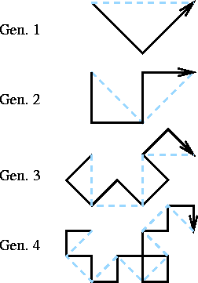
Dragon Curve
Starting from a base segment, replace each segment by 2 segments with a right angle and with a rotation of 45° alternatively to the right and to the left:
Gen 0

Slide 22
Hilbert Curve
Hilbert proved that, as the order tends to infinity, the infinitely thin, continuous line of the curve passes through every point of the unit square
[Drawing technique: Self Study]

Slide 23
Dimension of fractals
Fractals have infinite length but occupied in finite region
Lets apply this concept for simple line, square, and cube.
A straight line having unit length is divided into N equal segments, then length of each side is r = 1/N
A square having unit length sides, divided into N equal squares, then side of each small squares is r = 1/(N)^{1/2}
For N=4, we see
Similarly, a cube having unit length sides if divided into N equal cubes, then each side will have length r = 1/(N)^{1/3}
r = 1 / N^{1/D}
D= Dimension
½ → 1/(4)^{1/2}
1

Slide 24
Dimension of fractals
r = 1/N^{1/D}
N^{1/D} = 1/r
log N^{1/D} = log (1/r)
(1/D)log N = log (1/r)
D = log N / log (1/r)

Slide 25
Dimension of fractals
Koch Curve:
K0 to k1 → the base segment is divided into N = 4 equal segments each having length r = 1/3
So dimension is D = log N / log (1/r) = log 4 / log (3) = 1.26
Quadratic Koch Curve:
Q0 to Q1 → the base segment is divided into N=8 equal segments each having length r = 1/4
So dimension is D = log N / log (1/r) = log 8 / log (4)
= 1.5

Slide 26
Dimension of fractals
Dragon Curve:
d0 to d1 → the base segment is divided into N = 2 equal segments each having length r = 1/2^{1/2}
So dimension is D = log N / log (1/r) = log 2 / log (2^{1/2}) = 2 → dimension of square!

Slide 27
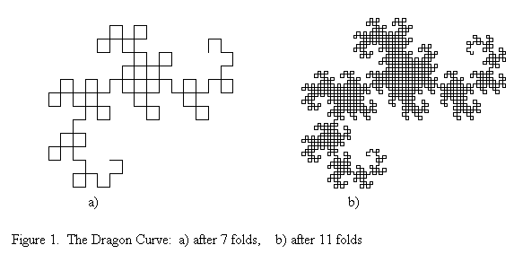
Dimension of fractals
So what we have learned?
Koch curve has dimension 1.26
Quadratic koch curve has dimension 1.5
Dragon curve has dimension 2
As Dimension increases, curve becomes plane filling

Slide 28
Peano curves
Fractal curves that have dimension 2 are called Peano curves
Dragon curve
Gosper curve
Hilbert curve

Slide 29
String production rule to draw fractals
The pseudocode can be converted to a set of String Production Rules
L-System
Notes:
Lindenmayer system

Slide 30
String production rule to draw fractals
Koch Curve
F → “F – F + + F – F”
F = go forward
= turn left through angle A degrees
+ = turn right through angle A degrees

Slide 31
String production rule to draw fractals
Koch Curve
This gives us first generation
S1 = F – F + + F – F
Replacing each F with same rules gives S2
S2 = (F – F + + F – F) – (F – F + + F – F) + + (F – F + + F – F) – (F – F + + F – F)
Applying repeatedly gives latter generations
F
→
F
–
F
+
+
F
–
F
60
60
60
60

Slide 32
String production rule to draw fractals
This technique is called Iterated Function System (IFS)
A string is repeatedly fed back into the same function to produce the next higher order object

Slide 33
Allowing branching
String production rule with special symbol for saving current state and restore to saved state
Current State
Current position, CP
Current direction, CD
Saving current state: [
Restore the last saved state: ]
Implementation: Using Stack
Save state: Push
Restore last saved state: Pop

Slide 34
Allowing branching
Example: Fractal Tree
F → “FF – [ - F + F + F ] + [ + F – F – F ] ”
Atom : F
Angle A: 22º
Replace each F by the same rule
D1
D2
P1
Gen 1
Gen 2
Saved State:
P1, D1
P1, D2

Slide 35
Mandelbrot Set

Slide 36
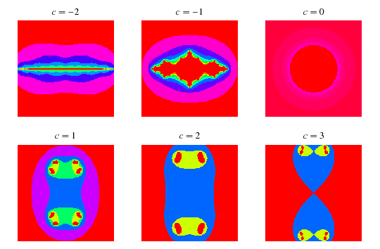
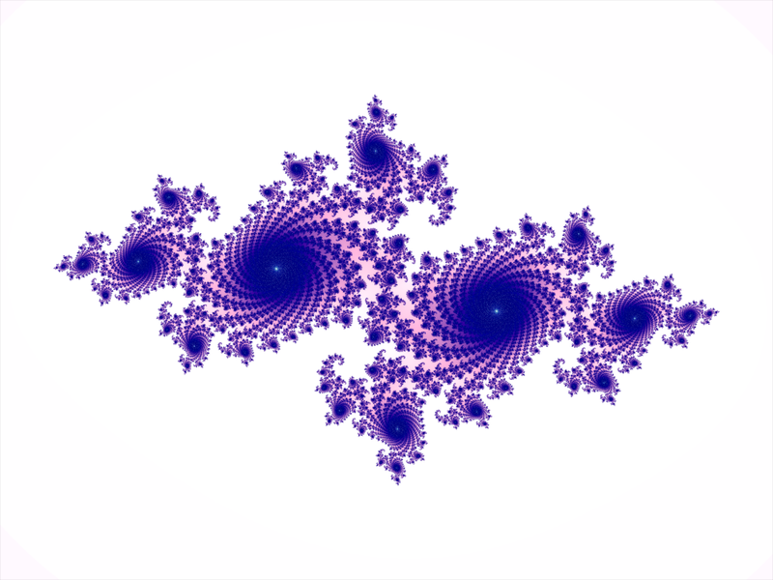
Julia set

Slide 37
Iterated function system
Iterated function system produce Mandelbrot set and Julia set from following function:
f (z) = z² + c
Let us choose starting value z=s
Then the sequence of values is:
d₁= (s)² + c
d₂= ((s)² + c)² + c
d₃= (((s)² + c)² + c)² + c
d₄= ((((s)² + c)² + c)² + c)² + c
This sequence is called orbit

Slide 38
Orbit
Orbit depends on
Starting value s
Constant c
How d_{k} acts with the given value of s and c as k increases?
Either remains finite → all points are in a finite distance from 0
Or they explode → shoot of to infinity

Slide 39
Finite Orbit
Example:
c= 0; s=1 : orbit contains: {1, 1, 1, 1, 1, …}
c= 0; s=1/2 : orbit contains: {1/2, 1/4, 1/8, 1/16, 1, …} (converging to zero)
C=-1; s=0: orbit contains: {0, -1, 0, -1, 0, -1, …}
C=-1.3; s=0: orbit contains: {0, -1.3, …, -1.148665, 0.019430, -1.299622, 0.389018, …} after 50 steps, converges to a periodic sequence of four values.

Slide 40
Exploding Orbit
Example:
c= 1; s=0 : orbit contains: 0, 1, 2, 5, 26, 677, … → explodes!

Slide 41
Complex numbers
What if s and c are complex?
Can result in Mandelbrot set and julia sets
In graphics, the complex numbers are displayed using a diagram
each complex number z= x+ yi is displayed at position (x, y)
Squaring a complex number gives another complex number
(x+yi)² = (x² – y²) + (2xy)i

Slide 42
Mandelbrot set & Julia Set
Application:
Study of phase transitions, In physics
It appears in some sort of electrical circuits
And many other

Slide 43
Mandelbrot set
Mandelbrot set M is the set of all complex numbers c which produce finite orbit with s=0
s=0
c= -0.2 + 0.5i
d₁= -0.2+ 0.5i
d₂= -0.41 + 0.3i
d₃= -0.1219 + 0.254i
d₄= -0.2497 + 0.4381i
…
After about 80 iterations, the d_{k} ’s converges to
d_{k} = -0.249227 + 0.333677i → fixed point of the function

Slide 44
Julia set
Filled in Julia set, Kc :
C = fixed
S= variable
At constant c, the Kc is the set of all starting points s whose orbits are finite
Julia set, Jc:
At constant c, Jc is the boundary of Kc.
Starting points s which are outside the boundary → explode
Starting points s which are inside the boundary → remains finite
Starting points s which lies on the boundary → on the fence → Julia set Jc

Slide 45
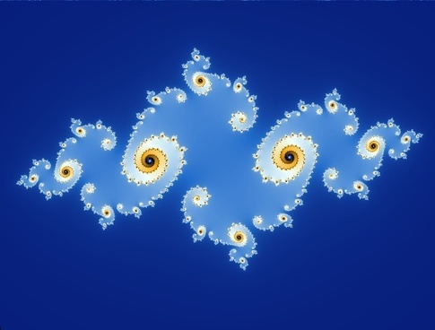
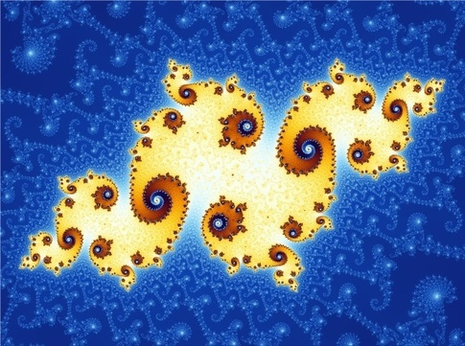
Mandelbrot & Julia set
Both lives in complex plane and thus studied in 'complex dynamics'
In Mandelbrot set M, S is zero and C varies. In Jc, c is given constant , and s varies. But in both case, c is complex number
If the Mandelbrot set near a specific complex number z is zoomed enough, it tends to look at lot like the Julia set for that number!
For example, c=z=−0.743643887037151+0.131825904205330i
Julia set for that number
ultra-closeup of the Mandelbrot set near that number

Slide 46
Hill (2nd Edition): 9.1 to 9.3, 9.6, 9.7

