Slide 1
Antialiasing

Slide 2
Aliasing:
Jagging / stair casing effect
Result of an all-or-nothing approach to scan conversion
Each pixel is either colored or left unchanged
Anti Aliasing:
The application of techniques that reduce or eliminate aliasing is known as Antialiasing.

Slide 3
Anti-aliasing techniques
Increase screen resolution
Costly
Area Sampling :
Unweighted Area Sampling
Weighted Area Sampling

Slide 4
Unweighted Area Sampling
Basic Idea:
Horizontal or Vertical line passes through one pixel per row / column
Lines at other angles go through multiple pixels per row / per column
A line is considered as a rectangle of a desired thickness covering a portion of the grid.

Slide 5
Unweighted Area Sampling
Basic Idea:
Pixels on the grid overlapped by the rectangle are colored to an appropriate intensity.
General rule : A line contributes to each pixel’s intensity an amount proportional to the percentage of the pixel’s tile it covers.
75%
25%
95%

Slide 6
Unweighted Area Sampling
Intensity of pixel centered at (x,y) :
I_{x,y} = I _{max} . dA . Weight
- dA = area overlap for pixel at (x,y)
- weight = 1 for unweighted area sampling

Slide 7
Unweighted Area Sampling (contd.)
Properties :
The intensity decreases with decreased area overlap.
Primitive cannot influence the intensity at a pixel if the primitive does not intersect it.
Equal areas contribute equal intensity, regardless of distance from pixel center to area.
Overlapping area is nearer
Overlapping area is farther

Slide 8
Weighted Area Sampling
3 Properties :
First and second properties are same to that of unweighted area sampling.
Property 3 has been modified here as below:
Equal areas contribute unequally : A small area closer to the pixel center has greater influence than does one at a greater distance.
Overlapping area is nearer
Overlapping area is farther

Slide 9
Weighted Area Sampling(contd.)
Remeber, the intesity for unweighted area sampling
Intensity of pixel centered at (x,y)
I_{x,y} = I _{max} . dA . Weight
Now, we need to construct a weighting function that gives less weight to area further away from pixel center than it does to equal but closer one.
So weighting must be decreasing function of distance.
Graph of such function forms a circular cone.

Slide 10
Weighted Area Sampling(contd.)
To obtain such weighting, pixel are considered as circular
Each pixel is considered to have conical volume.
Intensity at pixel (x,y) becomes :
I _{x,y} = I _{max} . W_{s}
where W_{s} is the sub volume of cone

Slide 11
Weighted Area Sampling(contd.)
Each circular pixel has radius of 1 unit so the pixels will be overlapping
Ensures that no area in the grid are not covered by some pixel
Notes:
Theoretical proofs and optimality about 1 unit radius are provided in Ch 14 (out of syllabus)

Slide 12
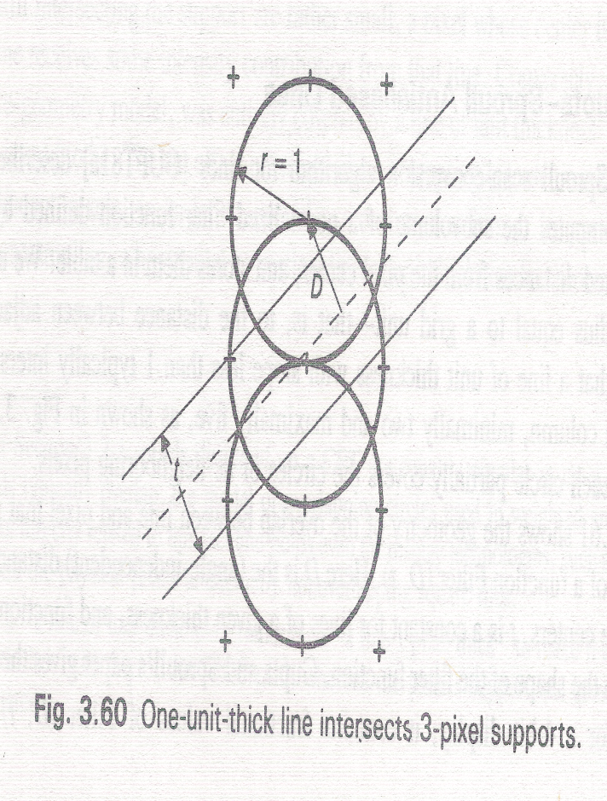
Weighted Area Sampling(contd.)
Each line intersects more than one pixel
Usually three pixels
Notes:
Theoretical proofs and optimality about 1 unit radius are provided in Ch 14 (out of syllabus)

Slide 13
Gupta-Sproull weighting Function
Use Gupta-Sproull weighting function Filter (D, t)
Gupta and Sproull’s paper gives a function, Filter (D, t)
For any pixel,
D= Perpendicular distance between pixel center and the line center
t= Constant for a line of given thickness
The paper gives a table that takes distance
D as index and provides corresponding
Filter(D, t) value i.e. Intensity.
Line center

Slide 14
Gupta-Sproull Antialiased Lines
Modifies the midpoint line scan algorithm
The decision variable d is used as before to choose between E and NE
Then Distance D between the chosen pixel to the line is computed
Using D, distances between its two vertical neighbor and the line: D_{up}, and D_{down} are computed.
Then intensity of chosen pixel and its two vertical neighbors are set, on the basis of the distances from these pixels to the line, using filter(D,t)
Chosen Pixel
Line center
Du
D
t
Dd

Slide 15
Calculation of D and V
The decision variable d is used as before to choose between E and NE
Let us choose E
D= perpendicular distance between chosen pixel (E) and line center
v= Vertical distance between chosen pixel (E) and line center
Line center

Slide 16
Calculation of D
For chosen pixel E,
D= perpendicular distance between chosen pixel (E) and line center
We know slope dy/dx
Apply the law of similar triangle

Slide 17
Calculation of V
For chosen pixel E,
v= Vertical distance between chosen pixel (E) and line center
positive if line center passes above the chosen pixel
negative if line center passes below the chosen pixel
Consider absolute value only

Slide 18
Calculation of v
v= Vertical distance between chosen pixel (E) and line center
Subtracting the y coordinate of E and intersecting point of line gives the vertical distance
Go from P=(x_{p},y_{p}) to E=(x_{p}+1,y_{p})
v = y coordinate of line at x_{p}+1 - y coordinate of E at x_{p}+1 = y’ – y_{p}
How to get y’ ?
Equation of Line, ax+by+c=0
So, y’=-(a(x_{p}+1)+ c) / b
Y’

Slide 19
Calculation of v
V = y’ – yp =-(a(x_{p}+1)+ c)/b – y_{p}
v(-b)= a(x_{p}+1) + c + by_{p}
v dx = a(x_{p}+1) + by_{p}+ c
(For avoiding fraction)
2 v dx = 2(a(x_{p}+1) + by_{p}+ c)
2 v dx = f(x_{p}+1,y_{p})
vdx =(a(x_{p}+1)+by_{p}+c)+½b -½b
vdx=(a(x_{p}+1) + b(y_{p}+½) + c) -½b
2vdx=2(a(x_{p}+1) + b(y_{p}+½) + c) - b
2vdx = f (x_{p}+1,y_{p}+1/2) – b = d – b = d + dx
Y’
Present In terms of M = d_{old} = f (x_{p}+1,y_{p}+1/2)

Slide 20
Calculation of D
So we have D, and v for selected pixel E
Now, find those for the two vertical pixels

Slide 21
Calculation of D
What if we go from P=(xp,yp) to NE=(x_{p}+1,y_{p}+1)?
2vdx = f(x_{p}+1,y_{p}+1)
= 2(a(x_{p}+1) + b(y_{p}+1) + c)
vdx = a(x_{p}+1) + b(y_{p}+1) + c
= (a(x_{p}+1) + b(y_{p}+1/2) + c ) + ½ b
= f(x_{p}+1,y_{p}+1/2)/2+ ½ b
=d/2 + b/2 = (d+b)/2
Chosen Pixel
Also find the values of D for
The pixel above NE and
The pixel below NE

Slide 22
Reference
Foley : Sec 3.17.1 – 3.17.4
Detailed calucalation of D (important)

