Slide 1
TEXTURE
CSE 410

Slide 2
Add Texture to Polygon
glEnable(GL_TEXTURE_2D);
glBindTexture(GL_TEXTURE_2D,texid); // here texid corresponds a bitmap image.
glNormal3f(1.0,0.0,0.0);
glBegin(GL_POLYGON);
glTexCoord2f(0,0); glVertex3f(47.5,7.3,-1.5);
glTexCoord2f(1,0); glVertex3f(47.5,7.3,1.5);
glTexCoord2f(1,1); glVertex3f(47.5,12.5,1.5);
glTexCoord2f(0,1); glVertex3f(47.5,12.5,-1.5);
glEnd();
glDisable(GL_TEXTURE_2D);
z
x
y

Slide 3
Add Texture To Cylinder
GLUquadricObj* IDquadric;
glEnable(GL_TEXTURE_2D);
glBindTexture(GL_TEXTURE_2D, texid); // here texid corresponds a bitmap image.
gluQuadricNormals(IDquadric,GLU_SMOOTH); //One normal is generated for every vertex of a quadric.
gluQuadricTexture(IDquadric, GLU_TRUE);//if texturing is desired for quadrics
gluCylinder(IDquadric, base ,top ,height, slices, stacks);
glDisable(GL_TEXTURE_2D);

Slide 4
Add Texture To Sphere
GLUquadricObj* IDquadric;
glEnable(GL_TEXTURE_2D);
glBindTexture(GL_TEXTURE_2D, texid);
gluQuadricNormals(IDquadric,GLU_SMOOTH);
gluQuadricTexture(IDquadric, GLU_TRUE);
gluSphere(IDquadric,Radius,slice,stack);
glDisable(GL_TEXTURE_2D);

Slide 5
Initilization Functions
For each texture image declare a global variable as follows
GLuint texid;
Within Init() call a function say func(), which loads bitmap images.

Slide 6
Func()
void func(void)
{
texid =LoadBitmap("bkg1.bmp"); /*here bkg1.bmp is the bitmap image to be used as texture, texid is global varible declared to uniquely identify this particular image*/
b =LoadBitmap("b.bmp");
stone = LoadBitmap("stone.bmp");
walltile = LoadBitmap("walltile.bmp");
checktile = LoadBitmap("checktile.bmp");
road = LoadBitmap("road.bmp");
brick = LoadBitmap("brick.bmp");
tiles = LoadBitmap("tiles.bmp");
c = LoadBitmap("c.bmp");
a = LoadBitmap("a.bmp");
}

Slide 7
LoadBitmap()
int num_texture = -1;
int LoadBitmap(char *filename)
{
int i, j=0;
FILE *l_file;
unsigned char *l_texture;
BITMAPFILEHEADER fileheader;
BITMAPINFOHEADER infoheader;
RGBTRIPLE rgb;
num_texture++;
if( (l_file = fopen(filename, "rb"))==NULL) return (-1);
fread(&fileheader, sizeof(fileheader), 1, l_file);
fseek(l_file, sizeof(fileheader), SEEK_SET);
fread(&infoheader, sizeof(infoheader), 1, l_file);
l_texture = (byte *) malloc(infoheader.biWidth * infoheader.biHeight * 4);
memset(l_texture, 0, infoheader.biWidth * infoheader.biHeight * 4);

Slide 8
for (i=0; i < infoheader.biWidth*infoheader.biHeight; i++)
{
fread(&rgb, sizeof(rgb), 1, l_file);
l_texture[j+0] = rgb.rgbtRed;
l_texture[j+1] = rgb.rgbtGreen;
l_texture[j+2] = rgb.rgbtBlue;
l_texture[j+3] = 255;
j += 4;
}
fclose(l_file);
glBindTexture(GL_TEXTURE_2D, num_texture);
glTexParameterf(GL_TEXTURE_2D, GL_TEXTURE_WRAP_S, GL_REPEAT);
glTexParameterf(GL_TEXTURE_2D, GL_TEXTURE_WRAP_T, GL_REPEAT);
glTexParameterf(GL_TEXTURE_2D, GL_TEXTURE_MAG_FILTER, GL_LINEAR);
glTexParameterf(GL_TEXTURE_2D, GL_TEXTURE_MIN_FILTER, GL_LINEAR_MIPMAP_NEAREST);
// glTexParameterf(GL_TEXTURE_2D, GL_TEXTURE_MIN_FILTER, GL_LINEAR);
glTexEnvf(GL_TEXTURE_ENV, GL_TEXTURE_ENV_MODE, GL_MODULATE);
glTexImage2D(GL_TEXTURE_2D, 0, 4, infoheader.biWidth, infoheader.biHeight, 0, GL_RGBA, GL_UNSIGNED_BYTE, l_texture);
gluBuild2DMipmaps(GL_TEXTURE_2D, 4, infoheader.biWidth, infoheader.biHeight, GL_RGBA, GL_UNSIGNED_BYTE, l_texture);
free(l_texture);
return (num_texture);
}

Slide 9
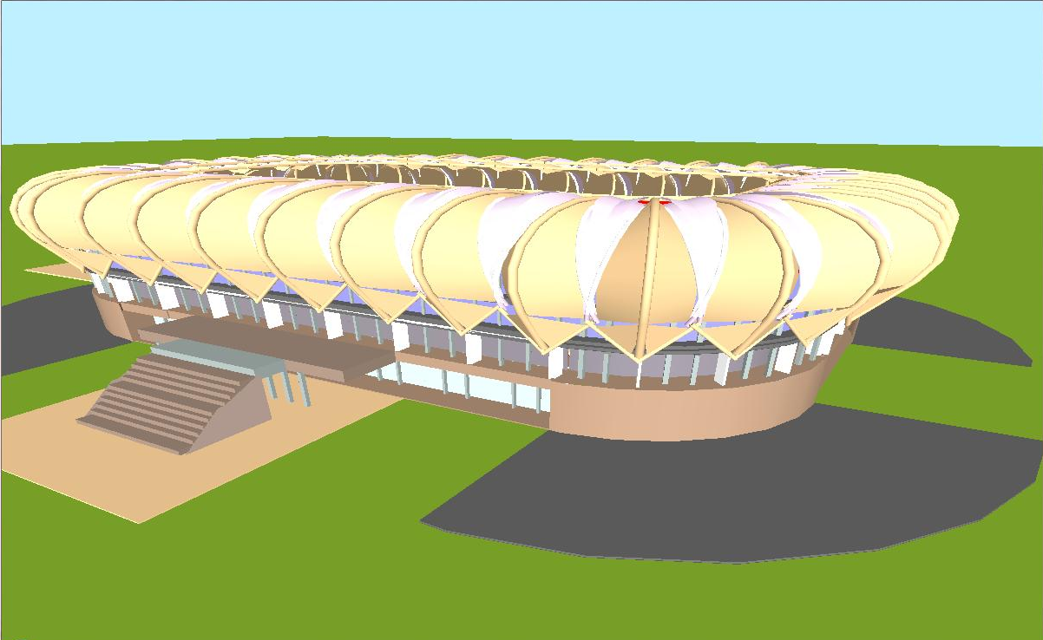

Slide 10
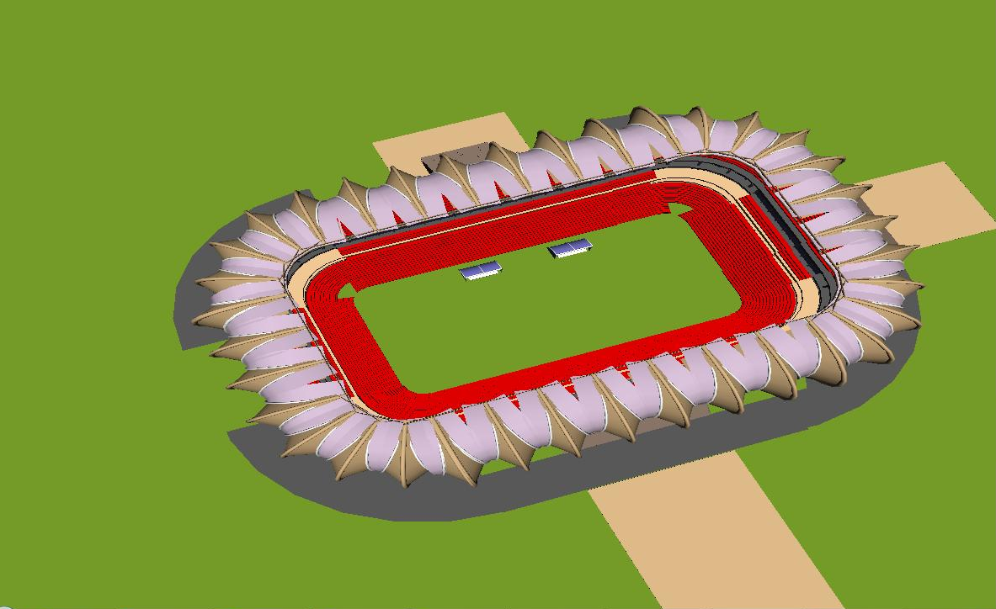

Slide 11
