Slide 1
Illumination
CSE 410

Slide 2
Basic steps of lighting
Enable smooth shading
Set global ambient light
glShadeModel(GL_SMOOTH);
glEnable(GL_NORMALIZE);
GLfloat global_ambient[] = { .3, .3, .3, 1.0 }; //white light
glLightModelfv(GL_LIGHT_MODEL_AMBIENT, global_ambient);
glEnable(GL_LIGHTING);
Draw the object
Color of Diffuse and Ambient Reflected component = Object’s color
Blue Sphere:
GLfloat mat_ambient[] = { 0.0, 0.0, 1.0, 1.0 };
GLfloat mat_diffuse[] = { 0.0, 0.0, 1.0, 1.0 };
glMaterialfv(GL_FRONT, GL_AMBIENT, mat_ambient);
glMaterialfv(GL_FRONT, GL_DIFFUSE, mat_diffuse);
glutSolidSphere(1.0, 36, 36);
Init()
Color
alpha
Display()

Slide 3
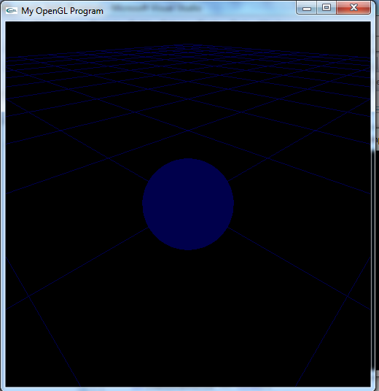

Slide 4
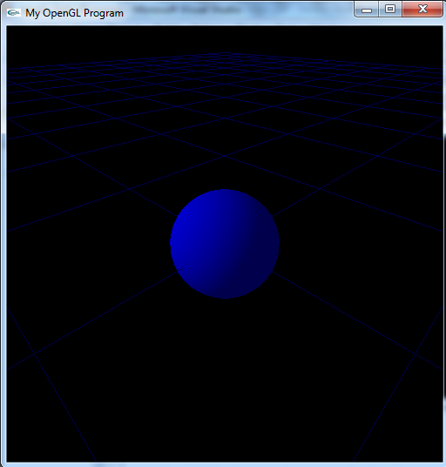
Directional Diffuse Light
GLfloat diffuseDir[] = {0.5, 0.5, 0.5, 1.0}; //Color (0.5, 0.2, 0.2)
GLfloat lightDir[] = {-1.0, 0.5, 0.5, 0.0}; //Coming from the direction (-1, 0.5, 0.5)
glLightfv(GL_LIGHT0, GL_DIFFUSE, diffuseDir);
glLightfv(GL_LIGHT0, GL_POSITION, lightDir);
glEnable(GL_LIGHT0);
Init()

Slide 5
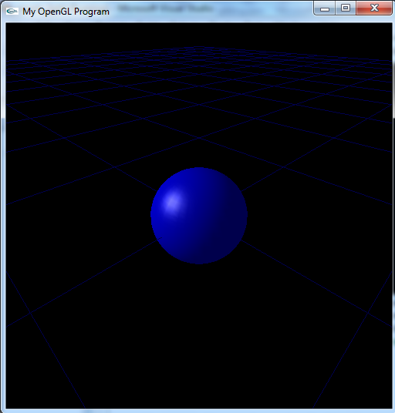
Add specular effect
GLfloat mat_specular[] = { 0.5, 0.5, 0.5, 1.0 }; //equal to the light source
GLfloat high_shininess[] = { 100.0 }; //high value → mirror like
glMaterialfv(GL_FRONT, GL_AMBIENT, mat_ambient);
glMaterialfv(GL_FRONT, GL_DIFFUSE, mat_diffuse);
glMaterialfv(GL_FRONT, GL_SPECULAR, mat_specular);
glMaterialfv(GL_FRONT, GL_SHININESS, high_shininess);
glutSolidSphere(3.0, 36, 36);

Slide 6
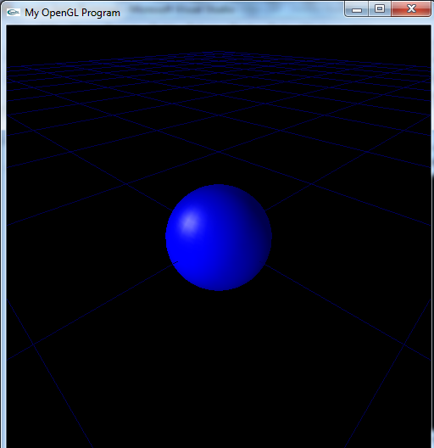
Directional Point Light
Light source:
GLfloat diffusePoint[] = {0.5, 0.5, 0.5, 1.0}; //Color (0.5, 0.5, 0.5)
GLfloat position[] = {-10.0, -10.0, 5.0, 1.0}; //Positioned at (-10, -10, 5)
glLightfv(GL_LIGHT1, GL_DIFFUSE, diffusePoint);
glLightfv(GL_LIGHT1, GL_POSITION, position);
Init()

Slide 7

Draw the light source:
GLfloat light_emission[] = {1.0, 1.0, 1.0, 1.0}; //object emits white light
glMaterialfv(GL_FRONT, GL_EMISSION, light_emission);
glPushMatrix();
glTranslatef (-10.0,-10.0,5);
glutSolidSphere(.5, 36, 36);
glPopMatrix();
Display()

Slide 8
Move the point light source around the object
GLfloat position[] = {-10.0*cos(Angle),-10.0*sin(Angle),5,1.0};
glLightfv(GL_LIGHT0, GL_POSITION, position);
GLfloat light_emission[] = {1.0, 0.0, 0.0, 1.0};
glMaterialfv(GL_FRONT, GL_EMISSION, light_emission);
glPushMatrix();
glTranslatef (-10.0*cos(Angle),-10.0*sin(Angle),5); // change angle based on key
glutSolidSphere(.5, 36, 36);
glPopMatrix();
Display()

Slide 9
What if the diffuse point/directional light source emits red colored light?
  Change the diffuse color property of the light source
  Change the emission color property of the object representing light source
  Also change the color of specular reflection of the object being illuminated

Slide 10
What if multiple diffuse point light sources exist ?
What about spot light?
What about different material properties?
What about textured surface?

Slide 11
Useful links
Hill: 8.2.8
http://www.glprogramming.com/red/chapter05.html
https://www.opengl.org/archives/resources/code/samples/redbook/
https://www.opengl.org/wiki/Code_Resources

